Slide 1
Tracker to aggregate using program indicator disaggregation
Jim Grace
jim@dhis2.org
Elmarie Claasen elmarie@hisp.org

Slide 2
Agenda
How it works
Implementations (Ghana and South Africa)
Tips and Tricks

Slide 3
Tracker to Aggregate (T-to-A)
Program indicator(s)
Event analytics
data values
Aggregate
data values
Aggregate Data Exchange
Faster analytics using summarized aggregate data values

Slide 4
Tracker to Aggregate (T-to-A), different instances
Program indicator(s)
Event analytics
data values
Aggregate
data values
Aggregate Data Exchange
Faster analytics using summarized aggregate data values
Tracker data need not exist on target instance

Slide 5
Program indicator disaggregation
Adds disaggregation dimensions to a program indicator (for example, age and gender)
category option combinations (COC)
and/or attribute option combinations (AOC)
Simplifies and speeds up T-to-A:
Fewer program indicators needed
Faster data access

Slide 6
T-to-A without program indicator disaggregation
Program indicators
Count enrollments where dose = BCG AND age = 0-11 months
Event analytics
data values
Aggregate
data values
One program indicator for each category option combination / attribute option combination

Slide 7
T-to-A using program indicator disaggregation
One program indicator
Count enrollments (all disaggregations)
Event analytics
data values
Aggregate
data values
One program indicator for all category option combinations and attribute option combinations

Slide 8
Category option filters
Category: Gender
Female: #{Zj7UnCAulEk.oZg33kd9taw} == 'Female'
Male: #{Zj7UnCAulEk.oZg33kd9taw} == 'Male'
Category: Age
<15: d2:yearsBetween(#{wYTF0YCHMWr.AZLp9Shoab9},V{event_date})<15
15+: d2:yearsBetween(#{wYTF0YCHMWr.AZLp9Shoab9},V{event_date})>=15

Slide 9
Category mappings
Category: Gender Mapping: standard Gender mapping Female: #{Zj7UnCAulEk.oZg33kd9taw} == 'Female’ Male: #{Zj7UnCAulEk.oZg33kd9taw} == 'Male’
Category: Age Mapping: age at event <15: d2:yearsBetween(#{wYTF0YCHMWr.AZLp9Shoab9},V{event_date})<15 15+: d2:yearsBetween(#{wYTF0YCHMWr.AZLp9Shoab9},V{event_date})>=15 Mapping: age at enrollment <15: d2:yearsBetween(#{wYTF0YCHMWr.AZLp9Shoab9},V{enrollment_date})<15 15+: d2:yearsBetween(#{wYTF0YCHMWr.AZLp9Shoab9},V{enrollment_date})>=15

Slide 10
Category mappings
Program indicator 1
Program A
Program indicator 2
Category mappings are defined in the program
Category mappings are used by program indicators

Slide 11
Program
Program
Category: Gender
Mapping: standard Gender mapping
Female: #{Zj7UnCAulEk.oZg33kd9taw} == 'Female’
Male: #{Zj7UnCAulEk.oZg33kd9taw} == 'Male’
Category: Age
Mapping: age at event
<15: d2:yearsBetween(#{wYTF0YCHMWr.AZLp9Shoab9},V{event_date})<15
15+: d2:yearsBetween(#{wYTF0YCHMWr.AZLp9Shoab9},V{event_date})>=15
Mapping: age at enrollment
<15: d2:yearsBetween(#{wYTF0YCHMWr.AZLp9Shoab9},V{enrollment_date})<15
15+: d2:yearsBetween(#{wYTF0YCHMWr.AZLp9Shoab9},V{enrollment_date})>=15

Slide 12
Program indicator
Program indicator
Disaggregation category combination: Gender + Age
Gender Mapping: standard Gender mapping
Age mapping: age at event
Attribute category combination: default

Slide 13
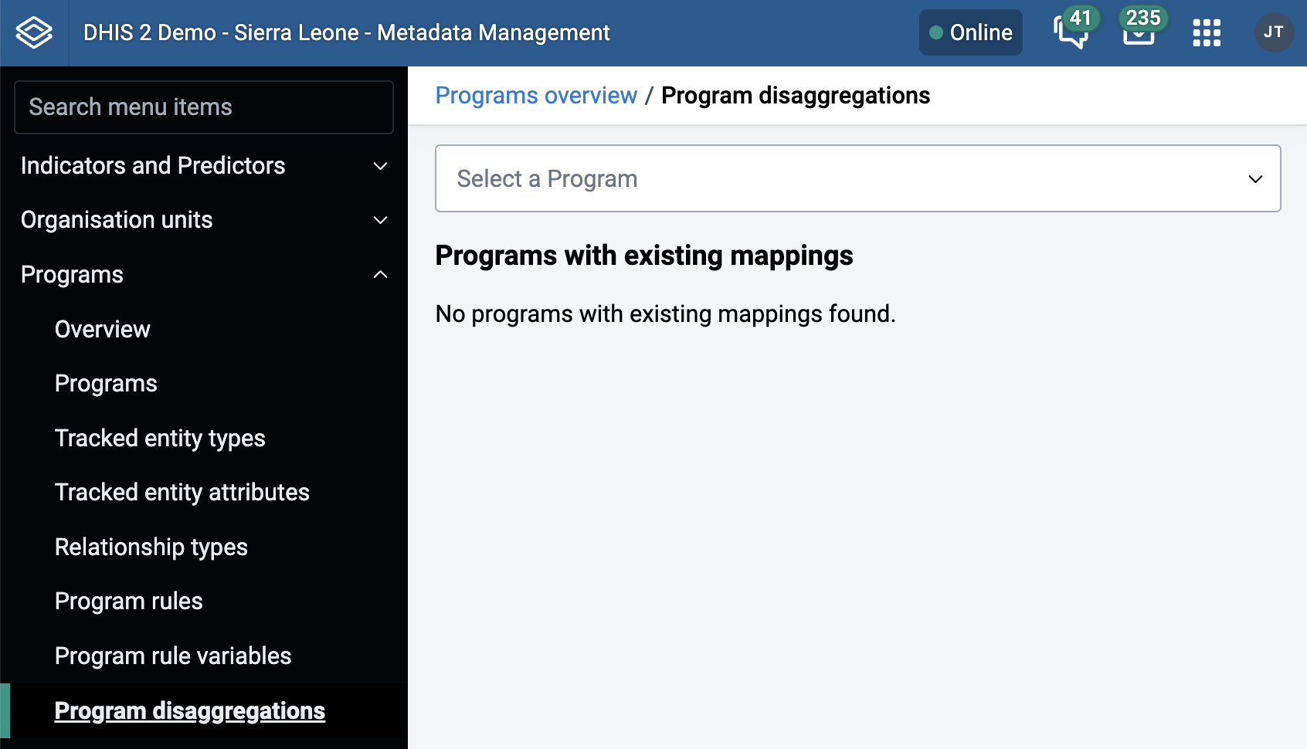
Configuring program indicator disaggregation

Slide 14
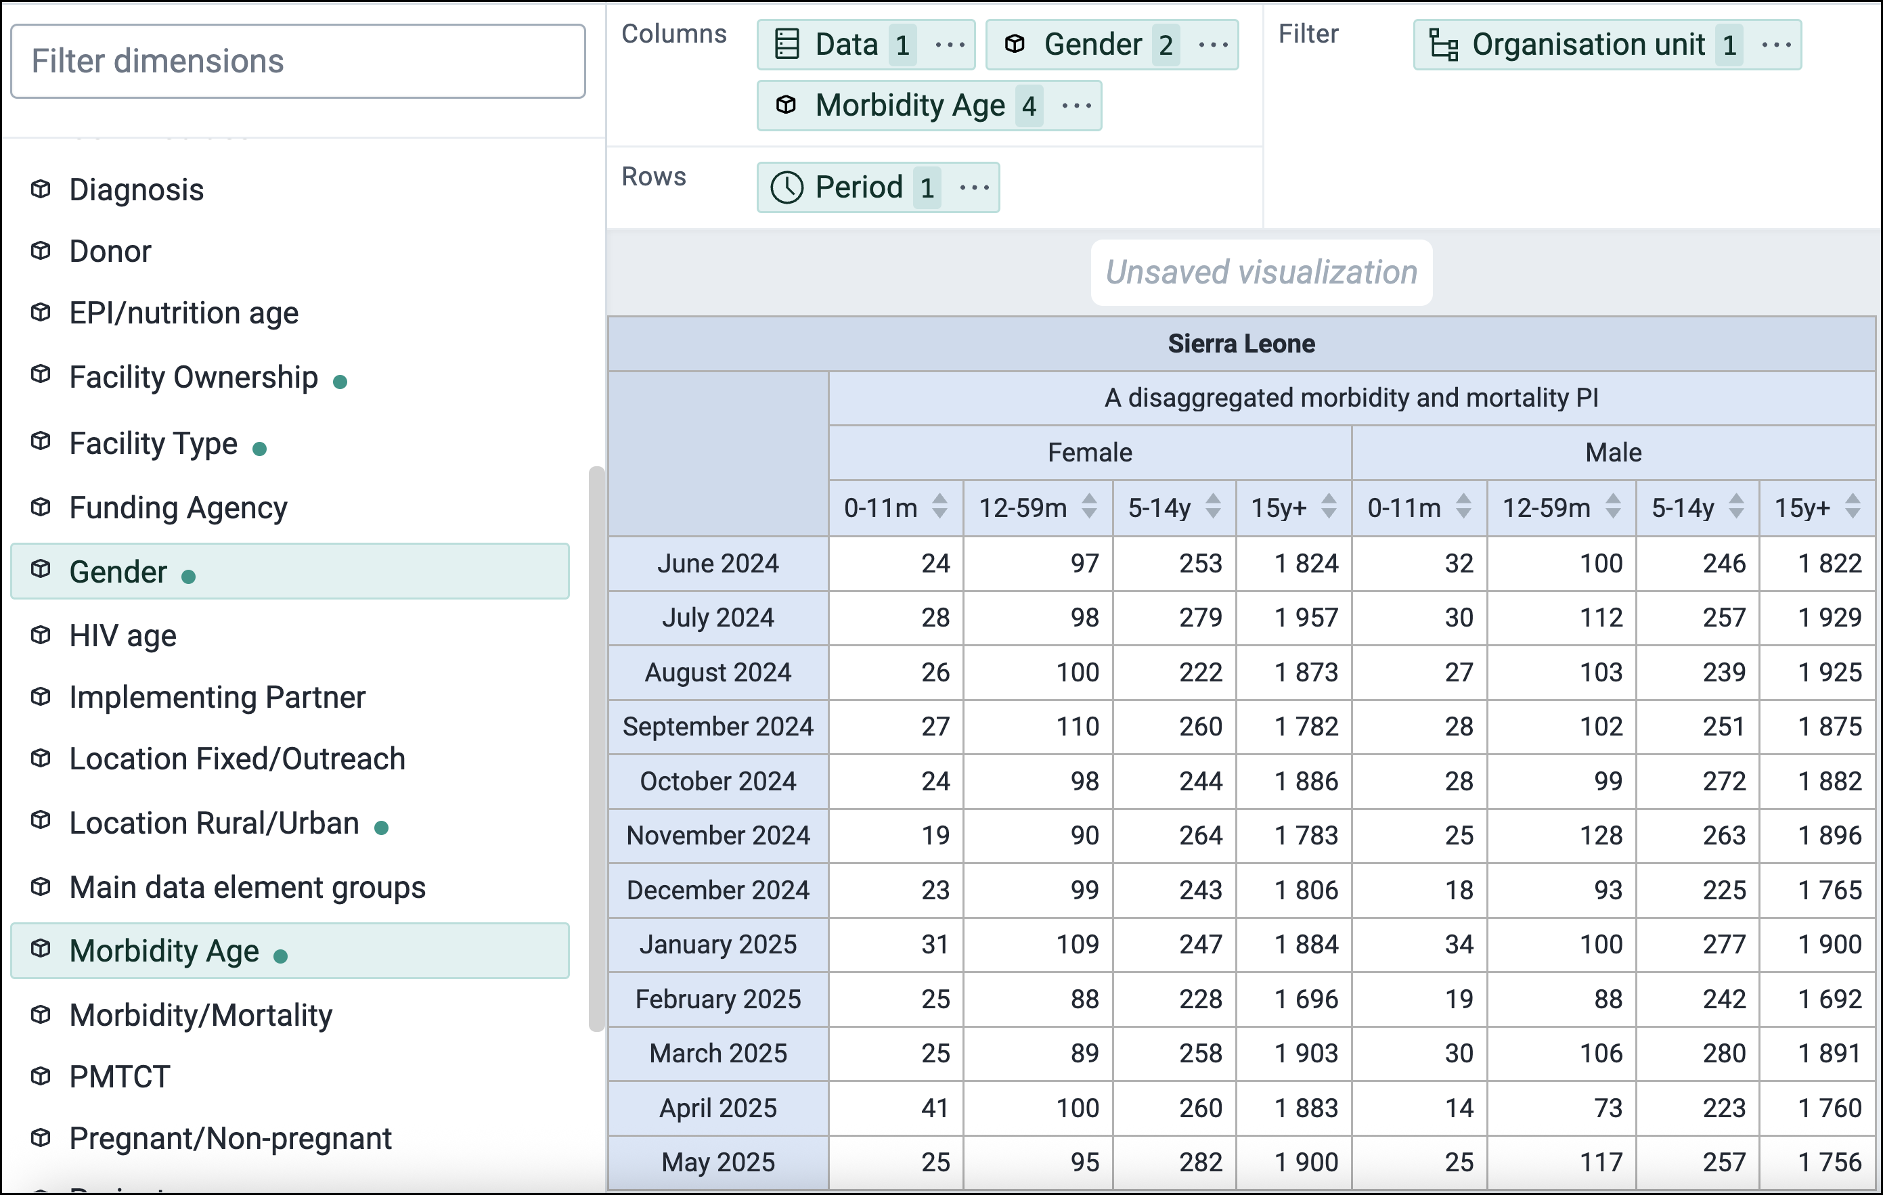
Program indicator disaggregation (Data Visualizer)

Slide 15
Agenda
How it works
Implementations (Ghana and South Africa)
Tips and Tricks

Slide 16
Ghana MOH instance for HIV (reported at DAC 2025)
27 program indicators (without disaggregation)
They need to convert to aggregate data with:
2 gender options and 11 age bands = 22 disaggregations
Without PI disaggregation they needed 27 x 22 = 594 program indicators,
each with a filter for a category option combination
Plus the original 27 undisaggregated program indicators = 621 PIs
With program indicator disaggregation, this reduces from 621 to 27 PIs.
All the category option filters are in one place in the program,
not in the 594 disaggregated PIs.

Slide 17
NACOSA instance for GC7 Adolescents and Young People Program for HIV vulnerable groups (South Africa)
(separate slides)

Slide 18
Agenda
How it works
Implementations (Ghana and South Africa)
Tips and Tricks

Slide 19
Building analytics tables
Build
event / enrollment
analytics tables
Event analytics
data values
Aggregate
data values
Build
aggregate
analytics tables
Aggregate
Data
Exchange
1
2
3

Slide 20
Overlaps and Gaps
Overlap:
More than one category option filter matches the data
Gap:
No category option filter matches the data

Slide 21
Overlap
More than one category option filter matches the data
Filters: 15-: #{Zsa6ohSheoX} <= 15
15+: #{Zsa6ohSheoX} >= 15
happens when: #{Zsa6ohSheoX} == 15
An overlap is always caused by filter misconfiguration
A data exchange run with an overlap is aborted and an error is logged

Slide 22
Gap
No category option filter matches the data
Filters: 15-: #{Zsa6ohSheoX} < 15
15+: #{Zsa6ohSheoX} > 15
happens when: #{Zsa6ohSheoX} == 15
or #{Zsa6ohSheoX} is null
A gap is caused by a filter misconfiguration or missing data
No error is returned and no data is returned for that event/enrollment

Slide 23
How to avoid gaps for missing data
You can define a category option and filter for missing data:
Note: Don’t define a single category option such as “unknown” and use it in more than one category in the same category combination. It won’t work in program indicator disaggregations (at least for now!) Instead, define different category options such as:
under 15 years: | #{Zsa6ohSheoX} < 15
15 and over: | #{Zsa6ohSheoX} >= 15
unknown age: | isNull(#{Zsa6ohSheoX})
unknown age
unknown gender

Slide 24
Categories, catCombos, catOptions, and catOptionCombos must be local
If you are using aggregate data exchange to a remote system with program indicator disaggregation:
The local system must have the same as the target system:
CategoryCombo
Categories
Category Options
Category Option Combos
They can have different names on the local system but the Category Option Combos must have the same identifiers.

Slide 25
New dhis.conf options starting with v42
New dhis.conf options (showing defaults):
metadata.categories.max_options = 50 (31 in v42.0, 50 in v42.1)
metadata.categories.max_per_combo = 5
metadata.categories.max_combinations = 500
If you need larger values, add one or more of these entries to your dhis.conf

Slide 26
Scripting program indicator disaggregation metadata
If you want to script the configuration of program indicator disaggregations using the WebAPI, the Developer Manual shows the JSON format needed for:
Program category option mappings
Program indicator category mapping selection
See: Developer Manual / Metadata / Programs
https://docs.dhis2.org/en/full/develop/dhis-core-version-master/developer-manual.html#webapi_programs

Slide 27
Thank you!
Jim Grace
jim@dhis2.org
Elmarie Claasen elmarie@hisp.org

